Slide 1

Lecture 5: Image as an Input – Convolutional Neural Network
Hands on Artificial Intelligence and Robotics
Lingxiao Wang, Ph.D.
Assistant Professor of Electrical Engineering
Louisiana Tech University

Slide 2
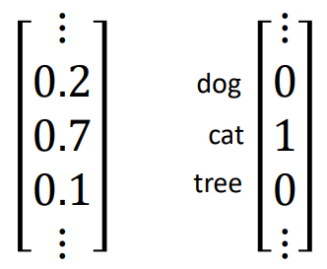
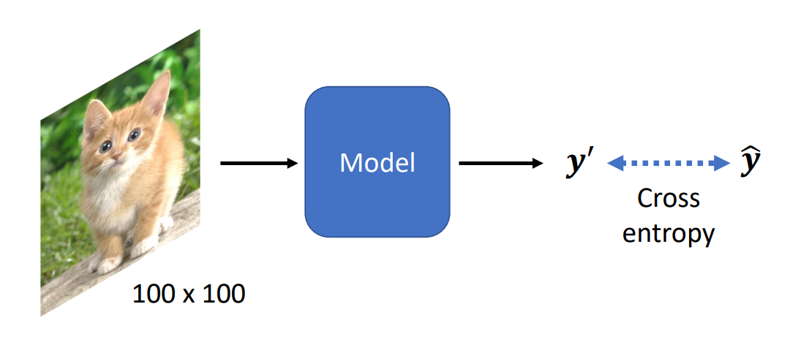
Introduction: Image Classification
The Objective of Image Classification:
Input: an image
Output: the category of objects in the input image
For instance:
Input: a 100 x 100 pixels image
Output: […, 0.2, 0.7, 0.1, …]
Notice that, once the model is determined, all the images to be classified should have the same size

Slide 3
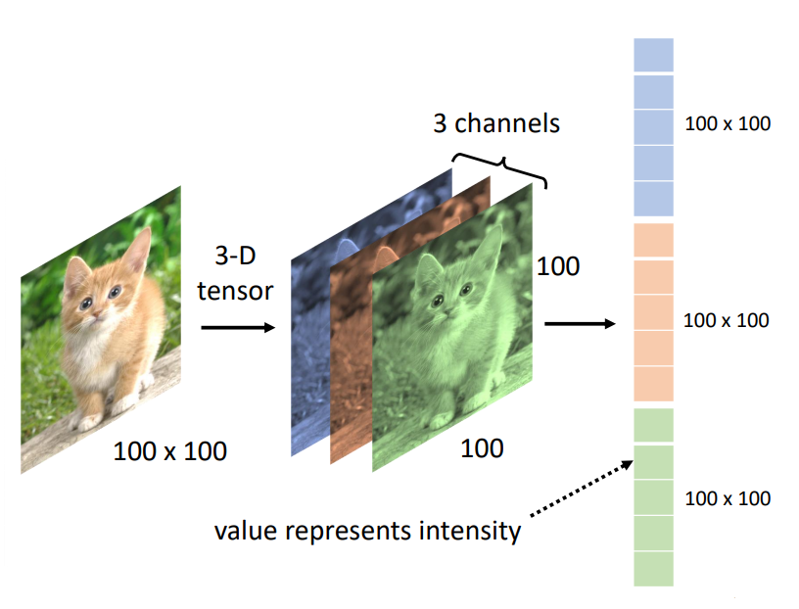
Introduction: Image Classification
In the image classification problem, the input image is a vector of pixels.
For a color image with the size of 100 x 100, it has 3 channels (red, yellow, blue), and each channel contains 100 x 100 pixels.
Combine 3 channels, we can get a color image.
For grey images (only has white and black), they have 1 channel.

Slide 4
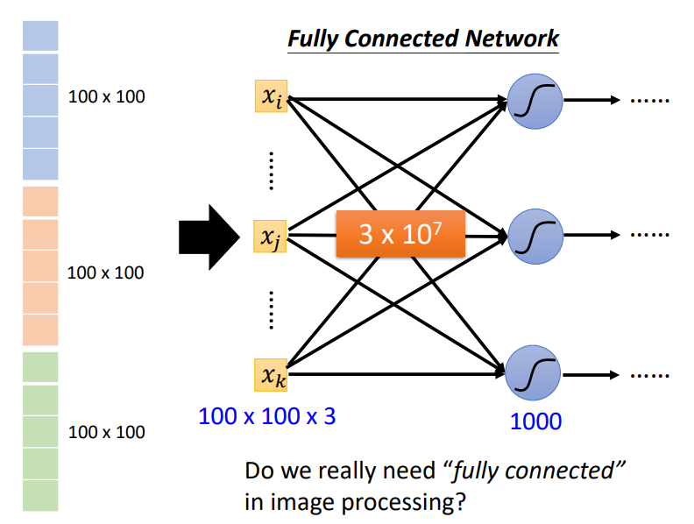
Image Classification with Fully Connected Networks
Since images are vectors to the model, can we use the regular fully connected neural network as the model to do the image classification task?
We can, but the input data size is too large, and the unknown parameters in the model is too many.

Slide 5
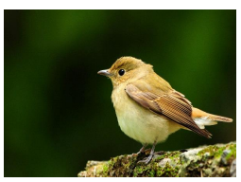
Observation 1
When humans identify the class of an object in the image, we will use some critical patterns instead of looking at single pixel.
For instance, can you identify the object in the following image?
How do you recognize this is a bird?
Find critical patterns, such as feet, eyes, beak, etc.
Critical Patterns

Slide 6
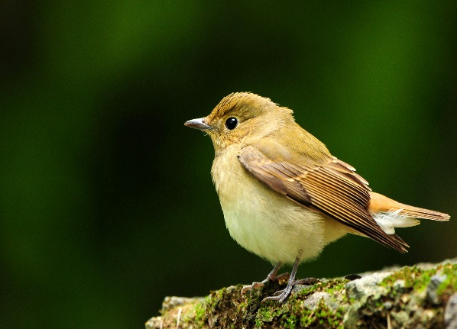

Observation 1
Identifying some critical patterns
Input
Layer 1
Layer 2
……
Bird?
……
……
……
……
……
Perhaps human also identify birds in a similar way … ☺
Notes:
https://www.dcard.tw/f/funny/p/233833012

Slide 7
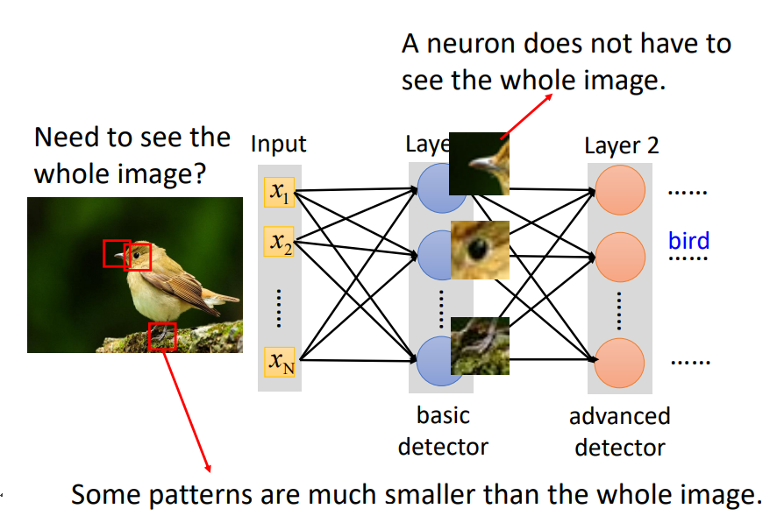
Observation 1
Thus, to identify the object in an image, the model does not need to see the whole image, instead, some critical patterns are sufficient enough to identify an object.

Slide 8
Simplification 1
3 x 3 x 3 weights
Instead of using a whole pic as an input, we can define a receptive field to observe critical patterns in an image.
The size of a receptive field can be changed.
3 x 3
…...
bias
1
Receptive field
1 | 0 | 0 | 0 | 0 | 1
0 | 1 | 0 | 0 | 1 | 0
0 | 0 | 1 | 1 | 0 | 0
1 | 0 | 0 | 0 | 1 | 0
0 | 1 | 0 | 0 | 1 | 0
0 | 0 | 1 | 0 | 1 | 0
3 x 3
…...
1 | 0 | 0 | 0 | 0 | 1
0 | 1 | 0 | 0 | 1 | 0
0 | 0 | 1 | 1 | 0 | 0
1 | 0 | 0 | 0 | 1 | 0
0 | 1 | 0 | 0 | 1 | 0
0 | 0 | 1 | 0 | 1 | 0
1 | 0 | 0 | 0 | 0 | 1
0 | 1 | 0 | 0 | 1 | 0
0 | 0 | 1 | 1 | 0 | 0
1 | 0 | 0 | 0 | 1 | 0
0 | 1 | 0 | 0 | 1 | 0
0 | 0 | 1 | 0 | 1 | 0
3 x 3
…...

Slide 9
Simplification 1
A neuron focuses on a receptive field, and receptive fields can overlap with others.
Even two neurons can focus on the same receptive field.
3 x 3 x 3 weights
Have the same receptive field
Receptive field
1 | 0 | 0 | 0 | 0 | 1
0 | 1 | 0 | 0 | 1 | 0
0 | 0 | 1 | 1 | 0 | 0
1 | 0 | 0 | 0 | 1 | 0
0 | 1 | 0 | 0 | 1 | 0
0 | 0 | 1 | 0 | 1 | 0
1 | 0 | 0 | 0 | 0 | 1
0 | 1 | 0 | 0 | 1 | 0
0 | 0 | 1 | 1 | 0 | 0
1 | 0 | 0 | 0 | 1 | 0
0 | 1 | 0 | 0 | 1 | 0
0 | 0 | 1 | 0 | 1 | 0
1 | 0 | 0 | 0 | 0 | 1
0 | 1 | 0 | 0 | 1 | 0
0 | 0 | 1 | 1 | 0 | 0
1 | 0 | 0 | 0 | 1 | 0
0 | 1 | 0 | 0 | 1 | 0
0 | 0 | 1 | 0 | 1 | 0
Can be overlapped

Slide 10
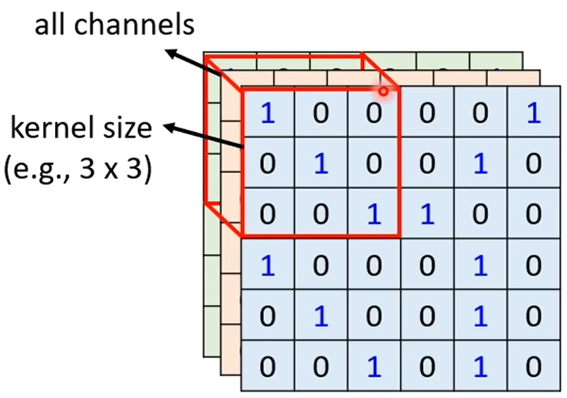
Simplification 1
Typical Settings of Receptive Fields:
A receptive field will consider pixels from all channels.
Thus, when you need to define the size of a receptive field, you only need to provide two-dimensional values (i.e., width and height, such as 3 x 3).
The size of a receptive field is named as kernel size.
Typical choice of kernel size is 3 x 3.
Each receptive field has a set of (repeated) neurons, such as 64 neurons.
In other words, 64 neurons focus on a receptive field.

Slide 11
Simplification 1 – Typical Setting
Each receptive field has a set of neurons (e.g., 64 neurons).
Move the receptive field horizontally or vertically to create a new receptive field.
The moving distance is named as stride.
Stride = 2
overlap
all channels
1 | 0 | 0 | 0 | 0 | 1
0 | 1 | 0 | 0 | 1 | 0
0 | 0 | 1 | 1 | 0 | 0
1 | 0 | 0 | 0 | 1 | 0
0 | 1 | 0 | 0 | 1 | 0
0 | 0 | 1 | 0 | 1 | 0
1 | 0 | 0 | 0 | 0 | 1
0 | 1 | 0 | 0 | 1 | 0
0 | 0 | 1 | 1 | 0 | 0
1 | 0 | 0 | 0 | 1 | 0
0 | 1 | 0 | 0 | 1 | 0
0 | 0 | 1 | 0 | 1 | 0
kernel size (e.g., 3 x 3)
1 | 0 | 0 | 0 | 0 | 1
0 | 1 | 0 | 0 | 1 | 0
0 | 0 | 1 | 1 | 0 | 0
1 | 0 | 0 | 0 | 1 | 0
0 | 1 | 0 | 0 | 1 | 0
0 | 0 | 1 | 0 | 1 | 0
Padding
Insert values (e.g., 0) at blank spaces of a receptive field.
The receptive fields cover the whole image.
Notes:
守的滴水不漏無懈可擊

Slide 12
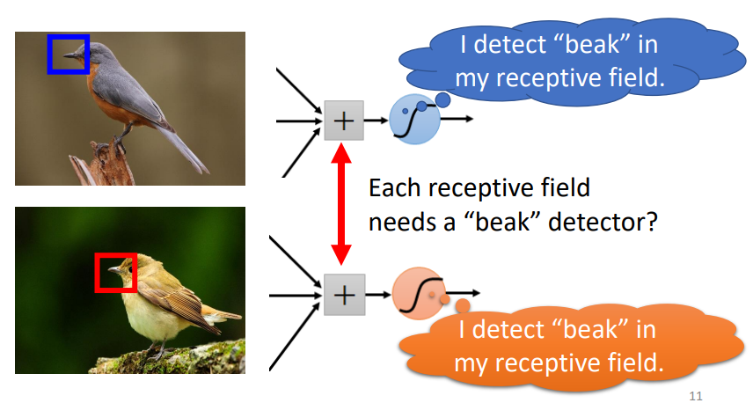
Observation 2
The same patterns may appear at different regions of an image.
For instance, in the above image, both neurons are responsible for detecting ‘beak’ in the image but in different receptive fields.
Can these two neurons share parameters since they are conducting the same job?

Slide 13
Simplification 2
3 x 3 x 3 weights
Sharing parameters -> two neurons have the same weights.
…...
bias
1 | 0 | 0 | 0 | 0 | 1
0 | 1 | 0 | 0 | 1 | 0
0 | 0 | 1 | 1 | 0 | 0
1 | 0 | 0 | 0 | 1 | 0
0 | 1 | 0 | 0 | 1 | 0
0 | 0 | 1 | 0 | 1 | 0
1
1 | 0 | 0 | 0 | 0 | 1
0 | 1 | 0 | 0 | 1 | 0
0 | 0 | 1 | 1 | 0 | 0
1 | 0 | 0 | 0 | 1 | 0
0 | 1 | 0 | 0 | 1 | 0
0 | 0 | 1 | 0 | 1 | 0
1 | 0 | 0 | 0 | 0 | 1
0 | 1 | 0 | 0 | 1 | 0
0 | 0 | 1 | 1 | 0 | 0
1 | 0 | 0 | 0 | 1 | 0
0 | 1 | 0 | 0 | 1 | 0
0 | 0 | 1 | 0 | 1 | 0
…
parameter sharing
3 x 3 x 3 weights
…...
bias
1
…

Slide 14










Simplification 2
$$x_{1}$$
$$σ\left(w_{1}x_{1}+w_{2}x_{2}+… \right)$$
$$x_{2}$$
$$w_{1}$$
…...
$$w_{2}$$
bias
1 | 0 | 0 | 0 | 0 | 1
0 | 1 | 0 | 0 | 1 | 0
0 | 0 | 1 | 1 | 0 | 0
1 | 0 | 0 | 0 | 1 | 0
0 | 1 | 0 | 0 | 1 | 0
0 | 0 | 1 | 0 | 1 | 0
1
1 | 0 | 0 | 0 | 0 | 1
0 | 1 | 0 | 0 | 1 | 0
0 | 0 | 1 | 1 | 0 | 0
1 | 0 | 0 | 0 | 1 | 0
0 | 1 | 0 | 0 | 1 | 0
0 | 0 | 1 | 0 | 1 | 0
1 | 0 | 0 | 0 | 0 | 1
0 | 1 | 0 | 0 | 1 | 0
0 | 0 | 1 | 1 | 0 | 0
1 | 0 | 0 | 0 | 1 | 0
0 | 1 | 0 | 0 | 1 | 0
0 | 0 | 1 | 0 | 1 | 0
…
$$x_{1}^{′}$$
$$σ\left(w_{1}x_{1}^{′}+w_{2}x_{2}^{′}+… \right)$$
$$x_{2}^{′}$$
$$w_{1}$$
…...
$$w_{2}$$
bias
Two neurons with the same receptive field would not share parameters.
1
…

Slide 15
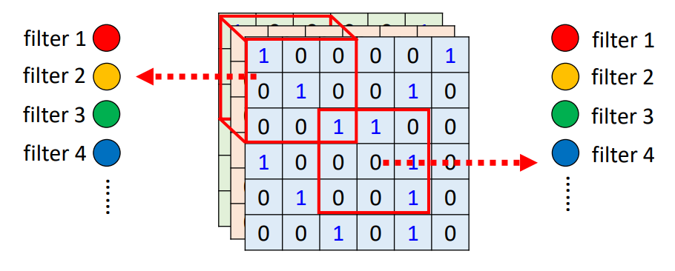
Simplification 2 – Typical Setting of Sharing Parameters
Each receptive field has a set of neurons (e.g., 64 neurons).
Parameters in these neurons are identical.
We call a neuron as a filter.
Each filter detects a critical pattern (e.g., beak)
In the below diagram, same color indicates the same weight values.

Slide 16
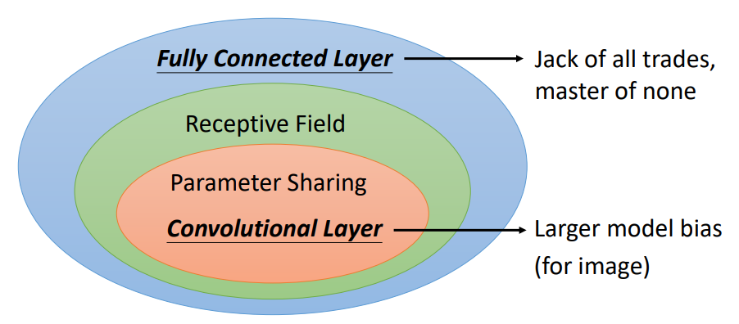
Convolutional Layer
Combining the above two simplification methods, we have the convolutional layer.
Receptive Field: instead of looking at the whole image, we just focus on critical patterns.
Parameter Sharing: the same pattern appear in different regions of an image. We can use a filter to detect a pattern.
A neural network that contains convolutional layer is called convolutional neural network (CNN).

Slide 17
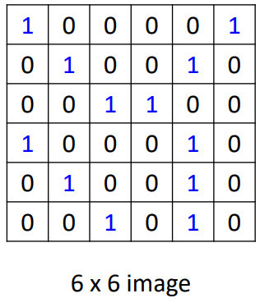
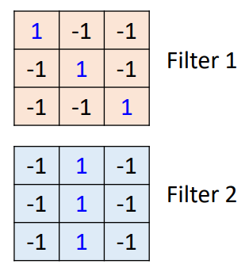
How does a Filter Detect a Pattern?
Suppose that we have a 6 x 6 image and two kinds of filters:
Parameters (weights) of a filter is unknown.
For demonstration purpose, we assume weights in these two filters obtained after the training.
When we apply a filter to the image, we need to calculate the inner-product of a filter and receptive field.
Thus, we can see that a large output value indicates that a filter detects the pattern.
X
= 3
= -1
= -3
X
= -1
= -1
= -1

Slide 18
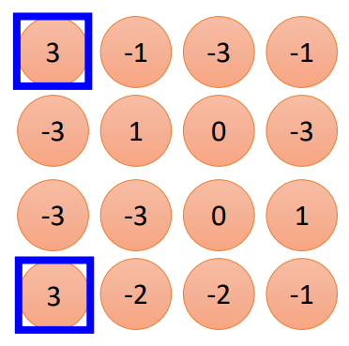
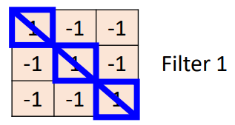
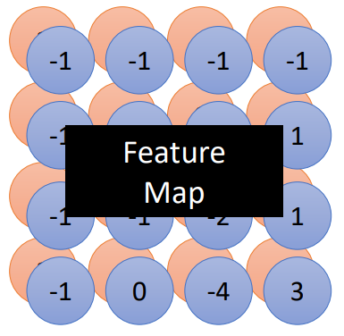
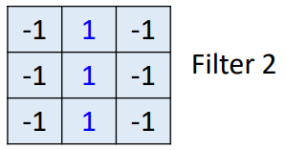
Convolutional Layer
Equation to calculate feature map dimension:
Output_size = (input_size – filter_size + 2 * padding)/stride +1
Using filters to scan the whole image we can get a feature map.
X
=
X
=

Slide 19
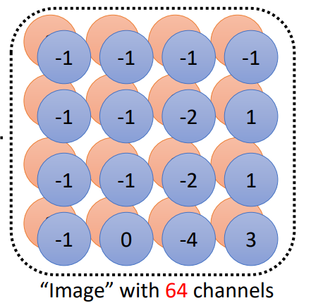
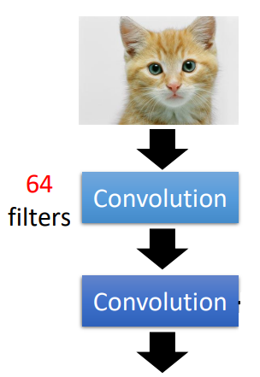
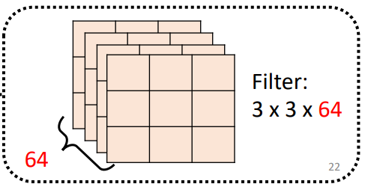
Convolutional Layer
For instance, we have a model with two convolutional layers.
Each convolutional layer has 64 filters.
The output of the first convolution layer is a feature map (or image) with 64 channels, and the size is 4 x 4 x 64.
The output of the second convolution layer is a feature map (or image) with the size of 3 x 3 x 64.

Slide 20
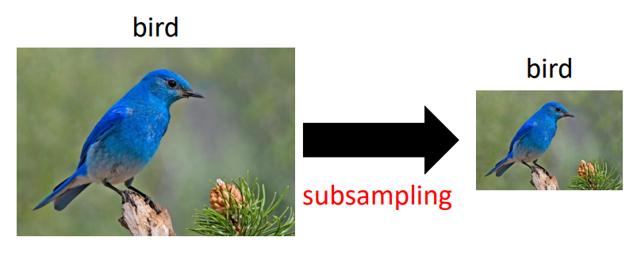
Observation 3
Subsampling the pixels will not change the object.
Notice that, subsampling is not to shrink an image but remove some pixels in an image.
The benefit of doing this is to reduce the input image size.
Size: 256 x 256
Size: 32 x 32

Slide 21
Pooling – Max Pooling
Based on observation 3, we design the max pooling operation.
Max pooling: pick the max pixel in a receptive field and remove all others.
1 | -1 | -1
-1 | 1 | -1
-1 | -1 | 1
-1 | 1 | -1
-1 | 1 | -1
-1 | 1 | -1
Filter 1
Filter 2
3
-1
-3
-1
-1
-1
-1
-1
-3
1
0
-3
-1
-1
-2
1
-3
-3
0
1
-1
-1
-2
1
3
-2
-2
-1
-1
0
-4
3
Notes:
It does not have parameters
Like activation function, like relu, sigmoid

Slide 22
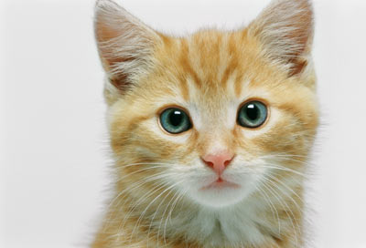
Convolutional Layers
+ Pooling
3
-1
-3
-1
-1
-1
-1
-1
-3
1
0
-3
-1
-1
-2
1
-3
-3
0
1
-1
-1
-2
1
3
-2
-2
-1
-1
0
-4
3
Convolution
“Image” with 64 channels
Repeat
Pooling
3
0
-1
1
3
1
0
3
……

Slide 23
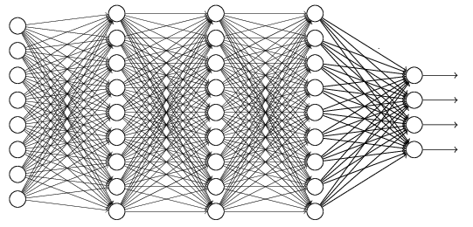
The whole CNN
cat dog ……
Convolution
softmax
Pooling
Fully Connected Layers
Convolution
Pooling
Flatten

Slide 24
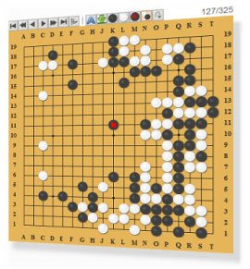
Application: Playing Go
Network
Next move
(19 x 19 positions)
19 x 19 classes
19 x 19 matrix (image)
19 x 19 vector
Black: 1
Fully-connected
network can be used
48 channels in Alpha Go
white: -1
none: 0
But CNN performs much better.
Notes:
Alpha Go is more complex.

Slide 25
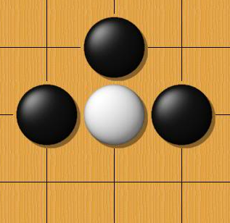
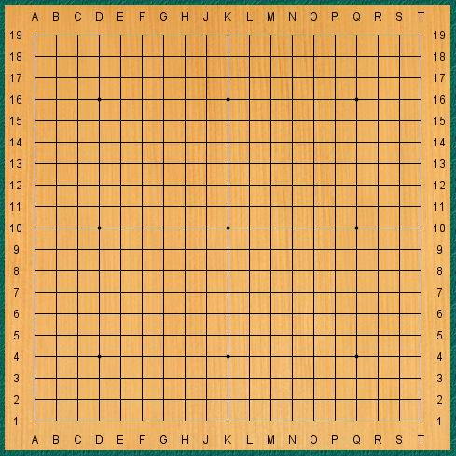
Why CNN for Go playing?
Some patterns are much smaller than the whole image
The same patterns appear in different regions.
Alpha Go uses 5 x 5 for first layer

Slide 26
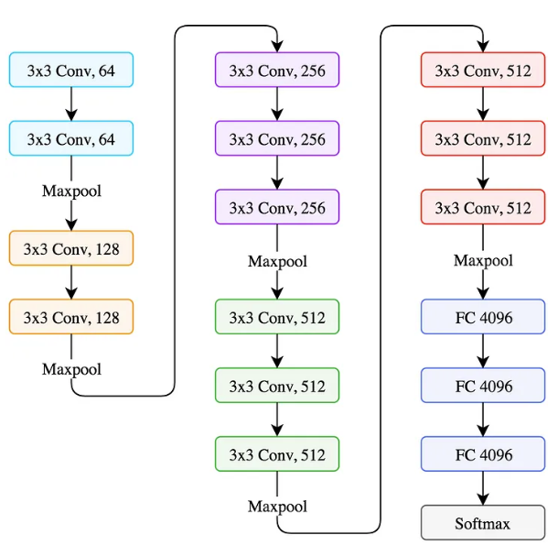
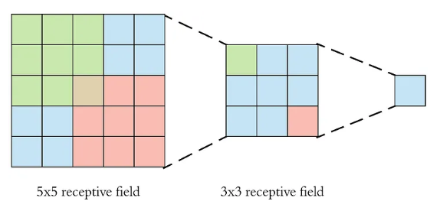
A Classic CNN Model: VGG
VGG (Visual Geometry Group) is a state-of-the-art CNN model in 2014.
VGG contains multiple convolutional and maxpooling layers.
VGG is a 16-layer network (not counting the maxpooling and the softmax layer)
It is also called VGG16.
It only uses 3x3 convolutions
Two back-to-back 3x3 convolution = One 5x5 receptive field.
Three back-to-back 3x3 convolution = One 7x7 receptive field.

Slide 27
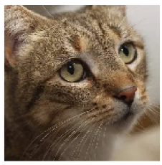
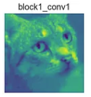
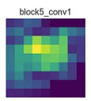
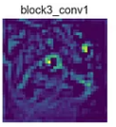
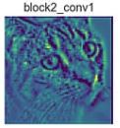
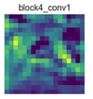
Visualization of VGG

Slide 28
Live Example
https://pytorch.org/tutorials/beginner/blitz/cifar10_tutorial.html

